Slide 1
Software testing
Se/2013/059
W.J.A.J.K. Wijesinghe

Slide 2
Introduction
Definition
What is Quality ?
Who does Testing ?
When to Start Testing ?
When to Stop Testing ?
Software Verification
Software Validation
Software Testing Levels
Software Testing Methods
Software Testing Standards
QA, QC & Testing

Slide 3

Definition
Software testing is a process of executing a program or application with the intent of finding the software bugs. It can also be stated as the process of validating and verifying that a software program or application or product: Meets the business and technical requirements that guided it's design and development.

Slide 4

What is quality ?
the standard of something as measured against other things of a similar kind; the degree of excellence of something.

Slide 5
Who does Testing?
Software Tester
Software Developer
Project Lead/Manager
End User

Slide 6
When to Start Testing ?
An early start to testing reduces the cost and time to rework and produce error-free software that is delivered to the client. However in Software Development Life Cycle SDLC, testing can be started from the Requirements Gathering phase and continued till the deployment of the software.

Slide 7
When to Start Testing ? (cont.)
During the requirement gathering phase, the analysis and verification of requirements are also considered as testing.
Reviewing the design in the design phase with the intent to improve the design is also considered as testing.
Testing performed by a developer on completion of the code is also categorized as testing.

Slide 8
When to Stop Testing ?
It is difficult to determine when to stop testing, as testing is a never-ending process and no one can claim that a software is 100% tested.

Slide 9
When to Stop Testing ? (cont.)
The following aspects are to be considered for stopping the testing process:
Testing Deadlines
Completion of test case execution
Completion of functional and code coverage to a certain point
Bug rate falls below a certain level and no high-priority bugs are identified
Management decision

Slide 10
Software Verification
Software verification is a discipline of software engineering whose goal is to assure that software fully satisfies all the expected requirements.
Source: Wikipedia
The process of evaluating a system or component to determine whether the product of a given development phase satisfy the conditions imposed at the start of that process.
Source: IEEE

Slide 11
Software Verification(Cont.)
Process - related
Am I building the product right ?
Am I accessing the right data ? (in the right place; in the right way)

Slide 12
Software Validation
Validation: process of evaluating a system or component during or at the end of the development process to determine whether it satisfies specified requirements.
Source: IEEE

Slide 13
Software Validation(cont.)
Product - related
Am I building the right product ?
Am I accessing the right data ? ( in terms of the data required to satisfy the customer requirements.)

Slide 14
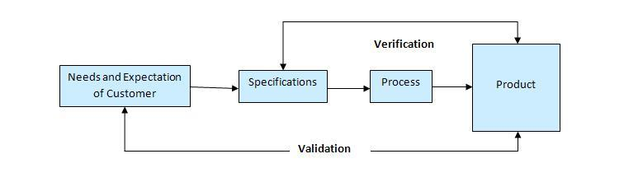
Verification vs. Validation

Slide 15
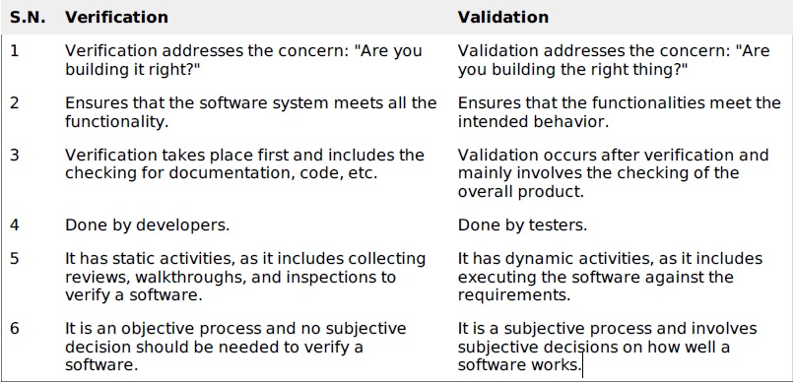
Verification vs. Validation (cont.)

Slide 16

software inspection and reviews
Inspection in software engineering, refers to peer review of any work product by trained individuals who look for defects using a well defined process. An inspection might also be referred to as a Fagan inspection after Michael Fagan, the creator of a very popular software inspection process.

Slide 17
SOFTWARE TESTING – LEVELS
Functional Testing
This is a type of black-box testing that is based on the specifications of the software that is to be tested. The application is tested by providing input and then the results are examined that need to conform to the functionality it was intended for. Functional testing of a software is conducted on a complete, integrated system to evaluate the system's compliance with its specified requirements.
Non-functional Testing
Non-functional testing involves testing a software from the requirements which are nonfunctional in nature but important such as performance, security, user interface, etc.

Slide 18
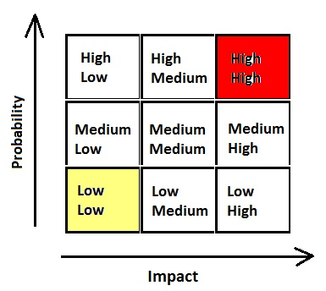
Test case prioritization
Test case prioritization provides a way to schedule and run test cases, which have the highest priority in order to provide earlier detect faults. Test Case Prioritization Techniques Prioritization for Rate of Fault Detection This goal is described as one of improving our test suite's rate of fault detection.

Slide 19

test automation
Automated testing tools are capable of executing tests, reporting outcomes and comparing results with earlier test runs. Tests carried out with these tools can be run repeatedly, at any time of day. The method or process being used to implement automation is called a test automation framework.

Slide 20
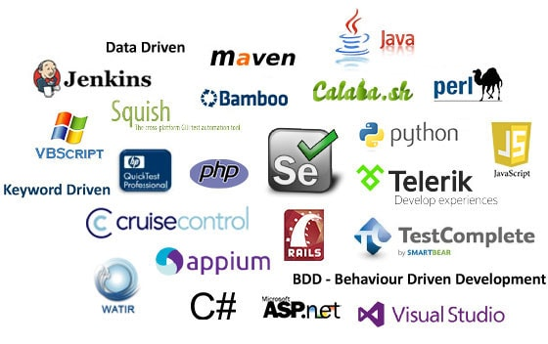
Test automation tools

Slide 21
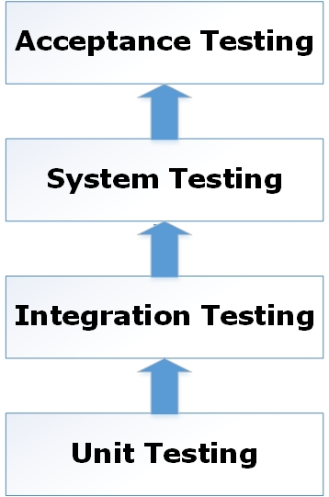
Functional Testing
Functional Testing
Unit Testing
Integration Testing
System Testing
Regression Testing
Acceptance Testing
Alpha Testing
Beta Testing

Slide 22
Non-functional Testing
Performance Testing
Load Testing
Stress Testing
Usability Testing
UI vs Usability Testing
Security Testing
Portability Testing

Slide 23
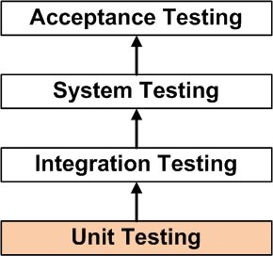
Unit testing
Unit Testing is a level of software testing where individual units/ components of a software are tested. The purpose is to validate that each unit of the software performs as designed. A unit is the smallest testable part of software. It usually has one or a few inputs and usually a single output.

Slide 24
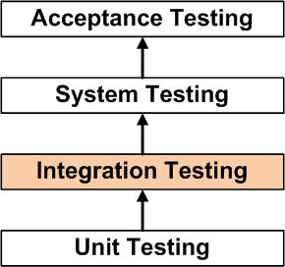
Integration Testing
Integration Testing is a level of software testing where individual units are combined and tested as a group.

Slide 25
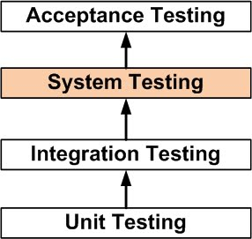
System Testing
System Testing is a level of the software testing where a complete and integrated software is tested. The purpose of this test is to evaluate the system’s compliance with the specified requirements.

Slide 26
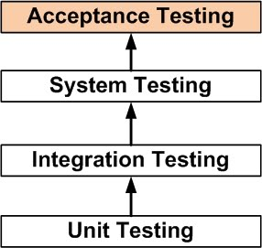
Acceptance Testing
Acceptance Testing is a level of the software testing where a system is tested for acceptability. The purpose of this test is to evaluate the system’s compliance with the business requirements and assess whether it is acceptable for delivery.

Slide 27
Alpha Testing
This test is the first stage of testing and will be performed amongst the teams developer and QA teams. Unit testing, integration testing and system testing when combined together is known as alpha testing. During this phase, the following aspects will be tested in the application:
Spelling Mistakes
Broken Links
Cloudy Directions
The Application will be tested on machines with the lowest specification to test loading times and any latency problems.

Slide 28
Beta Testing
This test is performed after alpha testing has been successfully performed. In beta testing, a sample of the intended audience tests the application. Beta testing is also known as pre-release testing. Beta test versions of software are ideally distributed to a wide audience on the Web, partly to give the program a "real-world" test and partly to provide a preview of the next release. In this phase, the audience will be testing the following:

Slide 29
Beta Testing (cont.)
Users will install, run the application and send their feedback to the project team.
Typographical errors, confusing application flow, and even crashes.
Getting the feedback, the project team can fix the problems before releasing the software to the actual users.
The more issues you fix that solve real user problems, the higher the quality of your application will be.
Having a higher-quality application when you release it to the general public will increase customer satisfaction.

Slide 30
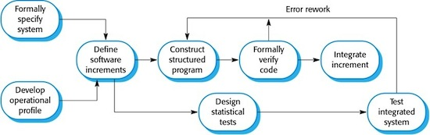
The cleanroom software engineering process
The cleanroom software engineering process is a software development process intended to produce software with a certifiable level of reliability. The cleanroom process was originally developed by Harlan Mills and several of his colleagues including Alan Hevner at IBM.

Slide 31
The cleanroom software engineering process - Central principles
Software development based on formal methods
Incremental implementation under statistical quality control
Statistically sound testing

Slide 32
SOFTWARE TESTING - METHODS
Black-Box Testing
White-Box Testing
Grey-Box Testing

Slide 33
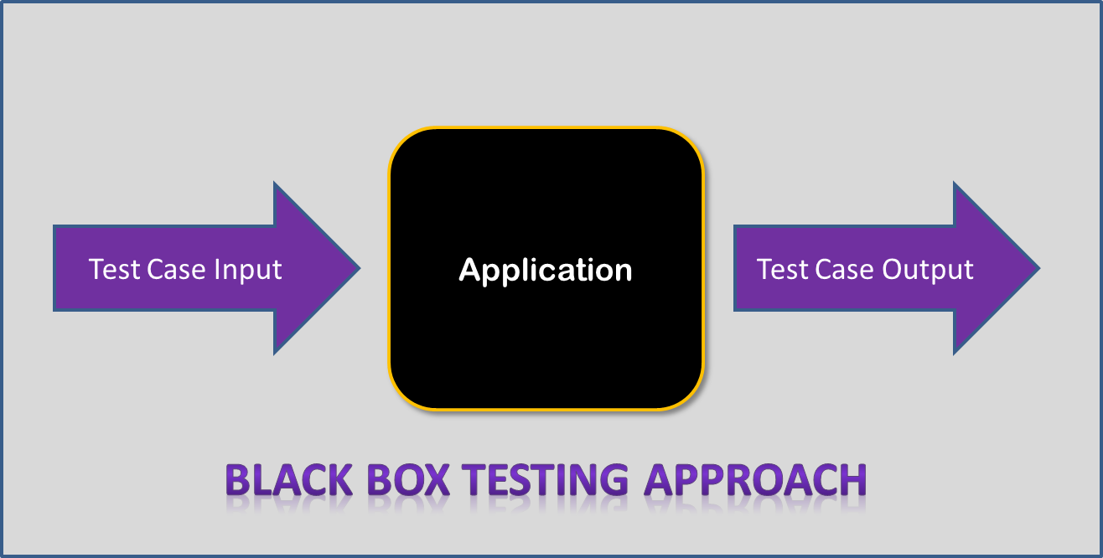
Black-Box Testing
Black-box testing is a method of software testing that examines the functionality of an application without peering into its internal structures or workings. This method of test can be applied virtually to every level of software testing: unit, integration, system and acceptance.

Slide 34
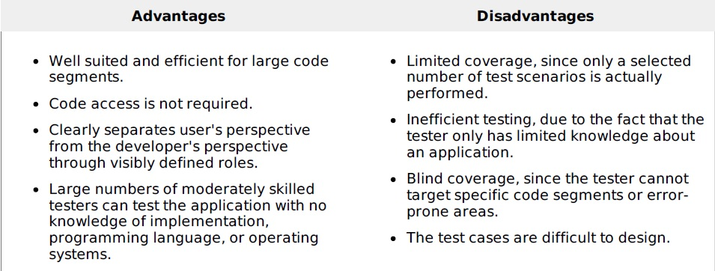
Black-Box Testing (cont.)

Slide 35
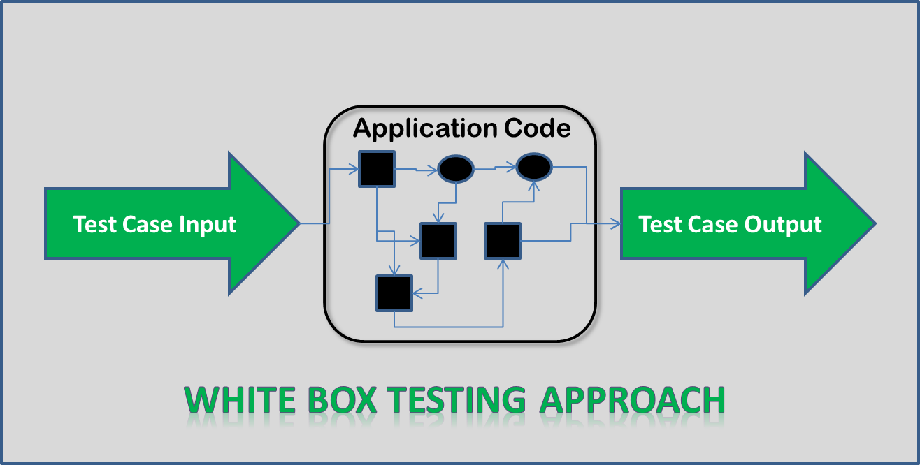
White-Box Testing
White-box testing (also known as clear box testing, glass box testing, transparent box testing, and structural testing) is a method of testing software that tests internal structures or workings of an application, as opposed to its functionality (i.e. black-box testing).

Slide 36
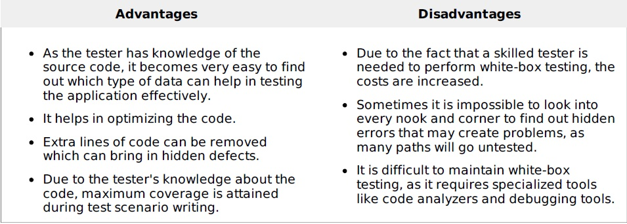
White-Box Testing (cont.)

Slide 37
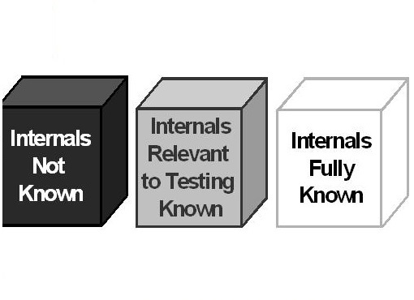
Grey-Box Testing
Gray box testing, also called gray box analysis, is a strategy for software debugging in which the tester has limited knowledge of the internal details of the program. A gray box is a device, program or system whose workings are partially understood.

Slide 38
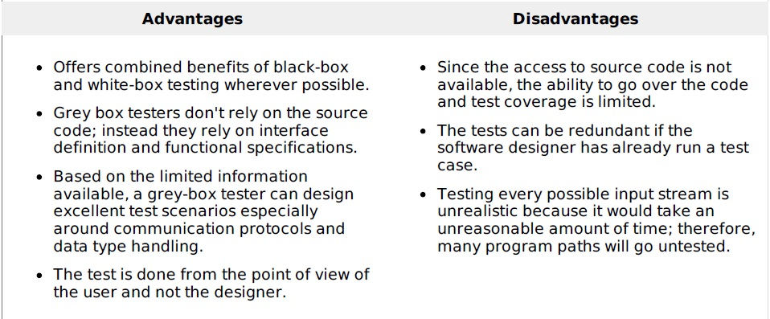
Grey-Box Testing (cont.)

Slide 39
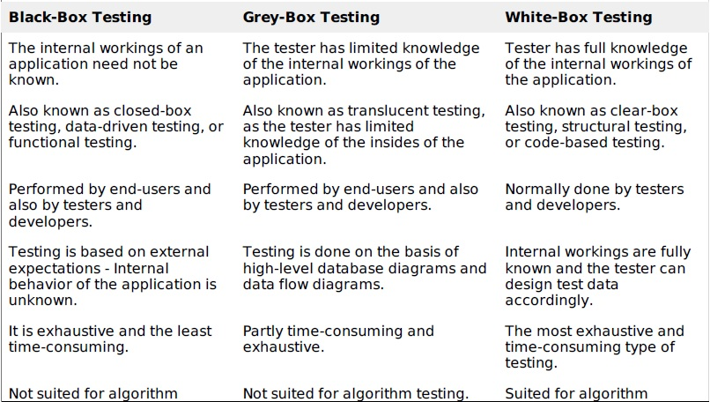
Comparison

Slide 40

Iso standards
ISO/IEC 9126
ISO/IEC 9241-11
ISO/IEC 25000:2005
ISO/IEC 12119

Slide 41
IEEE standards
IEEE 829 A standard for the format of documents used in different stages of software testing.
IEEE 1061 A methodology for establishing quality requirements, identifying, implementing, analyzing, and validating the process, and product of software quality metrics.
IEEE 1059 Guide for Software Verification and Validation Plans.
IEEE 1008 A standard for unit testing.
IEEE 1012 A standard for Software Verification and Validation.
IEEE 1028 A standard for software inspections.

Slide 42
IEEE standards
IEEE 1044 A standard for the classification of software anomalies.
IEEE 1044-1 A guide for the classification of software anomalies.
IEEE 830 A guide for developing system requirements specifications.
IEEE 730 A standard for software quality assurance plans.
IEEE 1061 A standard for software quality metrics and methodology.
IEEE 12207 A standard for software life cycle processes and life cycle data.
BS 7925-1 A vocabulary of terms used in software testing.
BS 7925-2 A standard for software component testing.

Slide 43
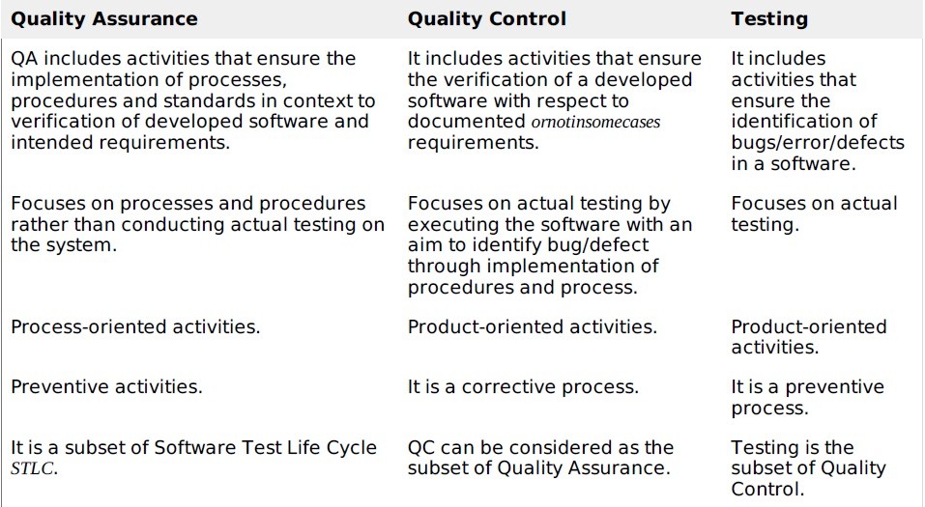
QA, QC & Testing

Slide 44
Questions ?

Slide 45
Thank You !

